Slide 1

Deep Q-Learning Snake Agent in PyTorch
DTE-2502 — Neural Networks Graded Assignment 02 Arghya Mukherjee

Slide 2
Assignment Requirements
Rewrite DQN agent in PyTorch
Keep environment nearly unchanged
Train the agent using Q-learning
Visualize gameplay with a video
Submit GitHub repo + model + video

Slide 3
Overview of Project Tasks
Understand provided Snake RL framework
Redesign learning component using PyTorch
Ensure compatibility with existing environment
Train + validate learning behavior
Provide reproducible code, model, and visual output

Slide 4
Environment (SnakeNumpy)
Board: 10×10 grid
State shape: (1, H, W, frames)
2-frame stack for motion
Actions: UP / DOWN / LEFT / RIGHT
Rewards: +10 food −1 death small step penalty

Slide 5
PyTorch Q-Network Architecture
CNN feature extractor
ReLU activations
Flatten → 2 fully-connected layers
Output: Q-values for each action
Optimizer: Adam (lr = 5e-4)
Loss: MSE

Slide 6
Replay Buffer
Stores transitions:
state
action
reward
next_state
done
Batch size: 64 Capacity: 60,000 samples Random sampling to break correlation

Slide 7
Training Logic
For each iteration:
Play frames (SnakeNumpy)
Store transitions in buffer
Sample minibatch
Compute target Q-values
Update online network
Sync target network periodically

Slide 8
Hyperparameters
Gamma: 0.99
Learning rate: 5e-4
Buffer size: 60k
Target update: periodic
Frames: 2 stacked
Training iterations: 200,000

Slide 9
Code Changes Required
Major modifications:
Replaced TensorFlow model → PyTorch DQN
Updated training.py
Updated visualize_game for SnakeNumpy
Fixed replay buffer indexing
Fixed action selection
Added model saving (.pth)

Slide 10
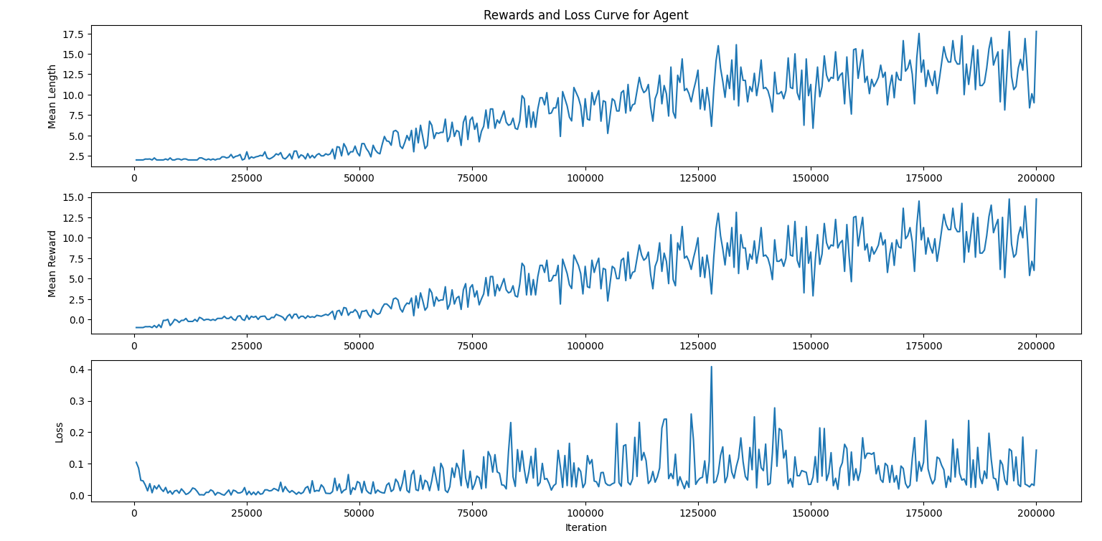
Training Results
Agent learned to survive ~120–150 frames
Eats food reliably
Avoids walls more often
Stable Q-values
Reward curve improves over time

Slide 11
Model Files
Saved in models/v17.1/:
model_200000.pth
model_200000_target.pth

Slide 12
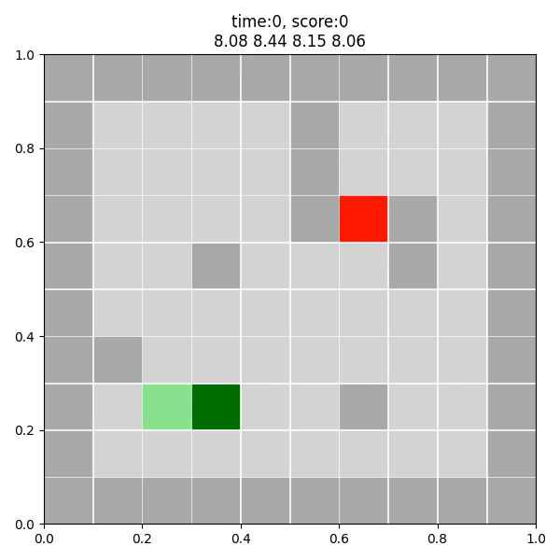
Gameplay Visualization
Used ffmpeg + matplotlib
Output: MP4 video
Shows predicted Q-values + score
Demonstrates learned policy

Slide 13
Key Components Implemented
PyTorch-based Q-Network
Custom replay buffer
Updated training loop
Visualization with ffmpeg
Environment integration
Model checkpointing
Config system (JSON)

Slide 14
Running the Project
Terminal commands: conda activate uitnn python training.py python game_visualization_torch.py
Dependencies:
PyTorch
NumPy
Matplotlib
ffmpeg

Slide 15
Conclusion
DQN implemented successfully in PyTorch
Environment + training fully functional
Agent learns meaningful behaviour
Video + model provided
All assignment requirements met

